Slide 1

Water Finder
An easier way to find water of all types for your industry
Brought to you by VioletPipeDreams

Slide 2
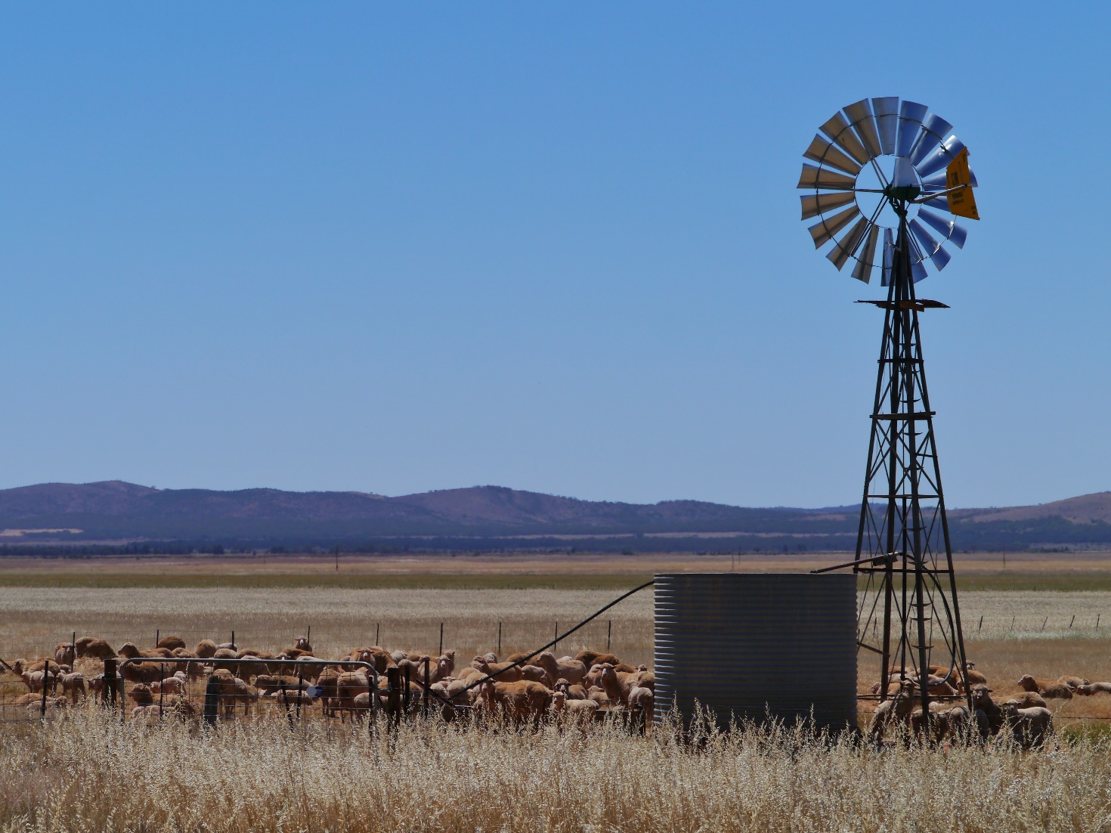
So what’s the problem?
Western Australia’s drying climate over recent years is making it harder to find and access water.
Our economy and communities are aiming to grow but a lack of water limits this.
Wastewater (99.97% water) can be harnessed and recycled for industrial, agricultural or recreation purposes.
A simple way to match available wastewater to suitable recipients has not been readily available or shared between government agencies.

Slide 3
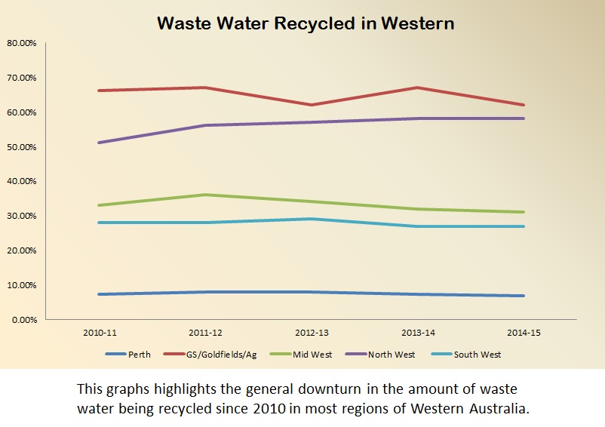
What’s already happening to fix the issue
The Water Corporation has a strategic target of 30% of the output of their wastewater treatment plants will be recycled by 2030.
In 2013, only 13.6 % of wastewater inflow to Water Corporation wastewater plants was recycled for a variety of uses such as:
Animal fodder
Public open space irrigation
Industrial water
We need to change the way we do business in order to reach these goals

Slide 4
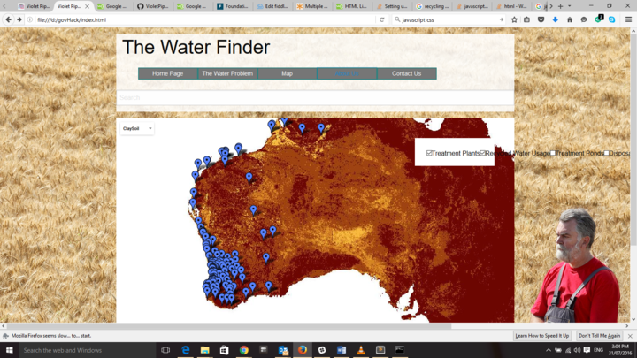
This is where Water Finder comes in
Water Finder is a simple, online portal that helps planners and potential recipients locate suitable wastewater reuse sites.
It maps
Water Corporation wastewater treatment plants
Wastewater storage
Soil types
Sites currently irrigated with wastewater
Public open spaces, racecourses, and schools that may be suitable for irrigation*
Drinking water catchments*
*Functionality not currently available.

Slide 5
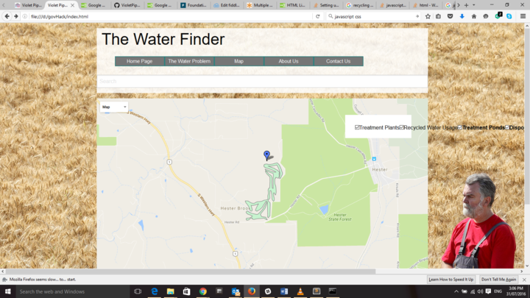
This is where Water Finder comes in

Slide 6
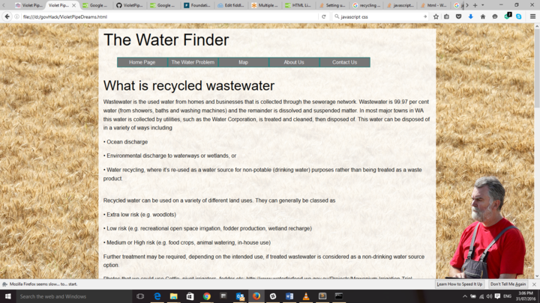
This is where Water Finder comes in
It also collates information from government regulators on
Department of Health guidelines for using recycled water
How to apply for access to wastewater
Grants that may help water recipients to build, operate or maintain new schemes
Case studies of existing recycled water schemes

Slide 7
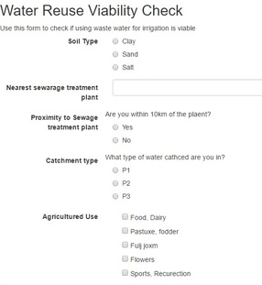
This is where Water Finder comes in
We’ve also created a simple form that quickly checks site feasibility.
It allows a user to see what potential issues they may find if they choose to pursue wastewater as a water source.
These include
Soil clay content
Proximity to treatment plant
Lack of available wastewater*
Proximity to catchment areas*

Slide 8
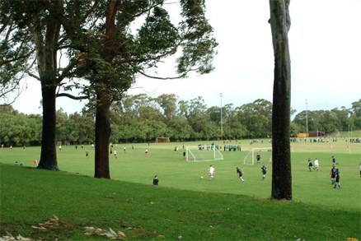
Opening data up to the community
This tool benefits WA by
Sharing government and community information with all relevant stakeholders
Collating the information in one place
Educating the public about issues that may constrain their use of this water
Visualising information spatially, which communicates locations more clearly
Encouraging the public to suggest to the government how our wastewater can be more useful

Slide 9
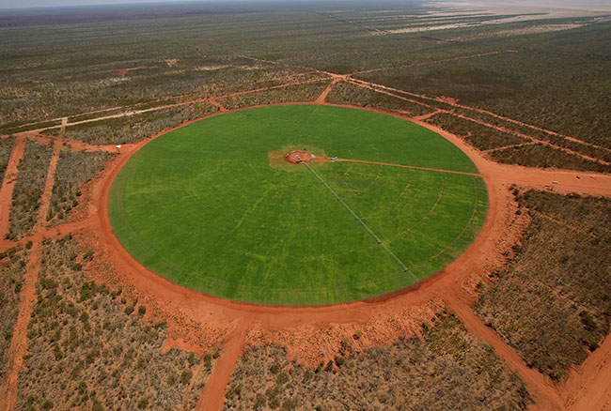
What will we do next?
Additional features that could be built into our portal include
Adding additional datasets to the map, especially recreation areas and schools
Expand functionality in the form
Water balance calculations to work out seasonal availability or allocation of water (limited by Water Corp data)
Potable water projects such as Water For Food, drinking water catchments and stormwater to cover all available water sources

Slide 10
Suggestions for data improvements
A valuable part of our project was finding limitations of existing data that, if corrected, could improve the value of Water Finder.
Water Corporation water balance data for each wastewater treatment plant, possibly with monthly variation.
Correcting errors in the wasterwater treatment plant points dataset where the point isn’t over the plant (e.g. Northam).
A finer detail localised soils dataset for WA.
Metadata for the Water For Food dataset
Publicly available datasets showing where agricultural land is around WA
More publicly available datasets of where recreation sites are around WA (e.g. racecourses, public open spaces). Currently the most visible information for this is kept in local maps or sites and are not easy to find or extract the data from.
Expand the wastewater irrigation areas dataset to cover all sites irrigated in the state (e.g. currently some Water Corporation sites or newer sites have nto been included)

Slide 11
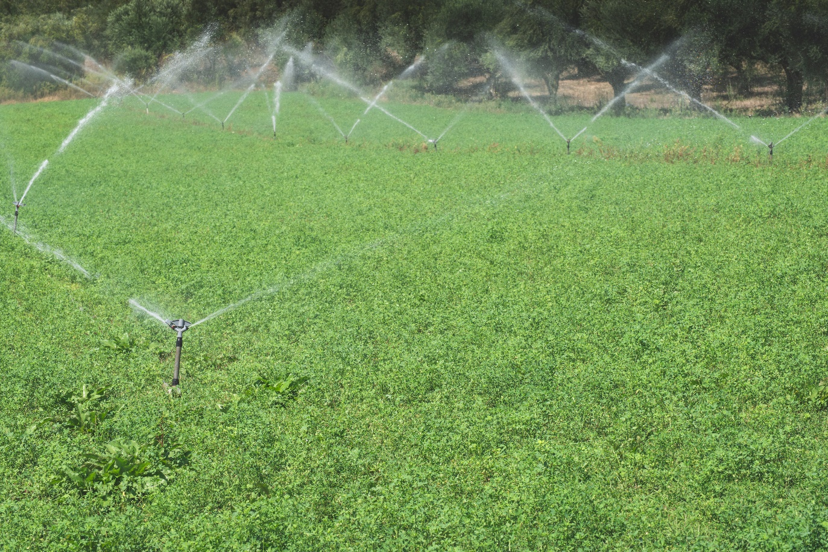
More questions about Water Finder
Contact us via the GovHackWA 2016 slack page and website
Contact Team Captain Louise Holbrook
Notes:
In Slide Show mode, click the arrows to visit links.

